Slide 1
Health Insurance Premium Prediction
Lakshayti Mathur - 14
Kopal Gupta - 41

Slide 2
About the Project

Slide 3
Aim of the Project
To identify the relationship between the personal data of customers and the insurance premium charged to them.
To build a model using regression to predict health insurance premium to be charged to customers based on their personal data.

Slide 4
Dataset Information
The dataset consists of 7 columns and 1338 rows
The Insurance Premium Charged to people are given along with their personal information which includes their:
Age
Sex
Body Mass Index
Number of Children
If they are smoker or not
Region which they belong to

Slide 5
Reason for Choosing this Dataset
Due to the on-going pandemic (Covid-19) a lot of people have decided to get their health insured as people realised the uncertainty of the situation.
So, a lot of health insurance companies are now coming up with different insurance policies as people are more concerned about the same.
Health Insurance domain has a lot of future potential and hence, we chose ‘Health Insurance Premium Prediction’ as our topic for this project.

Slide 6
Descriptive Analysis of Data

Slide 7
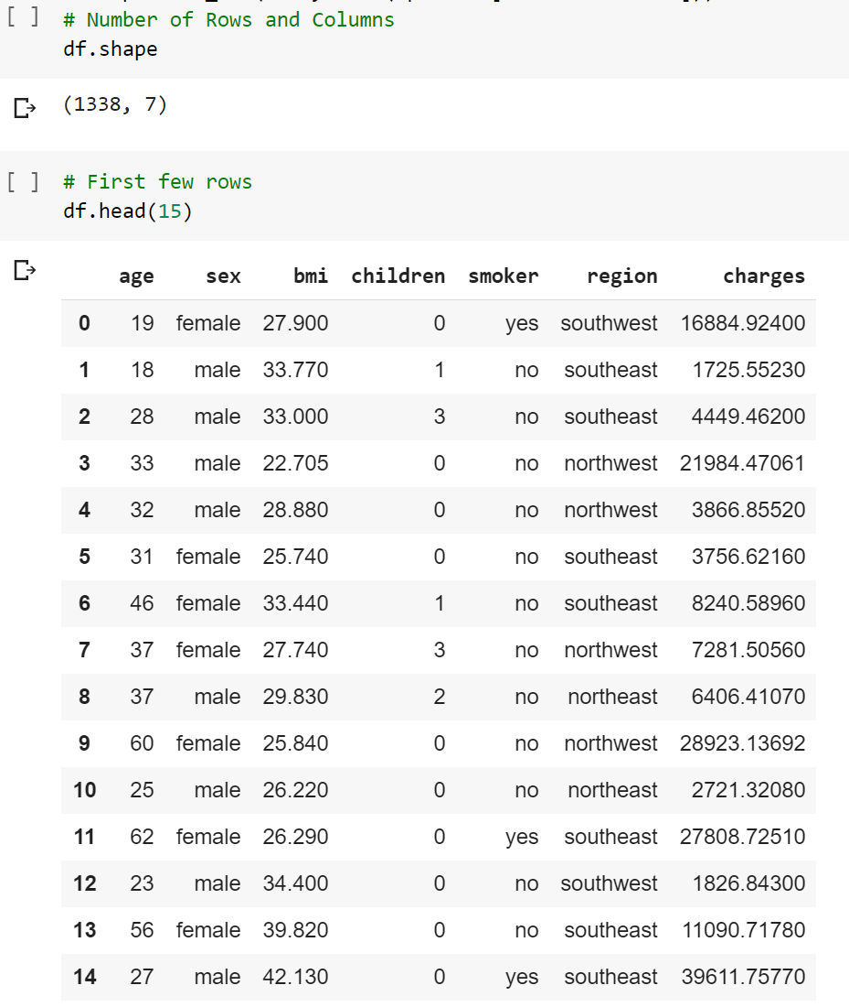
Viewing Dataset
The data has been loaded in the variable df
Information about the data can be viewed using
df.shape to get the number of rows & columns
df.head(15) to get first 15 rows of the data

Slide 8
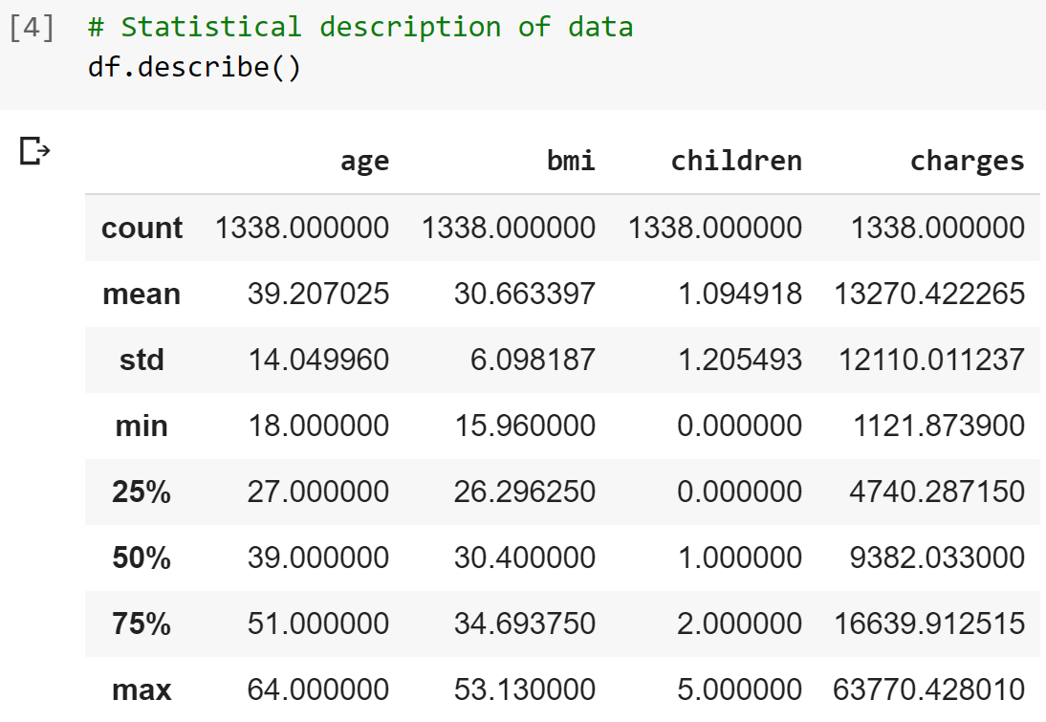
Data Description
Statistical Description of the data can be viewed using df.describe()

Slide 9
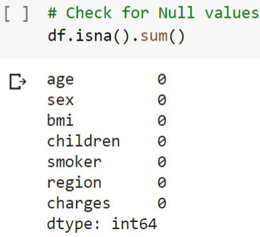
Data Cleaning & Preprocessing
In order to clean and preprocess the data, we looked for null values using the command df.isna().sum(). There were no null values in the data.

Slide 10
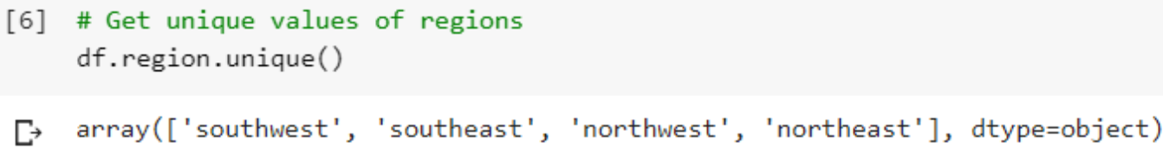
Finding Unique Values
Next, we found all the unique values of the categorical variable - Region.
The 4 categories of Regions were are:
Southwest
Southeast
Northwest
Northeast

Slide 11
Data Visualisation
We created histograms in order to visualise the distribution of data.
Most of the customers who got health insurance were aged between 20 to 25 years.
Most customers have a Body Mass Index around 30.
Most customers have no children followed by single child and 2 children.
Most customers are charged a premium of less than Rs 10,000 per year.

Slide 12
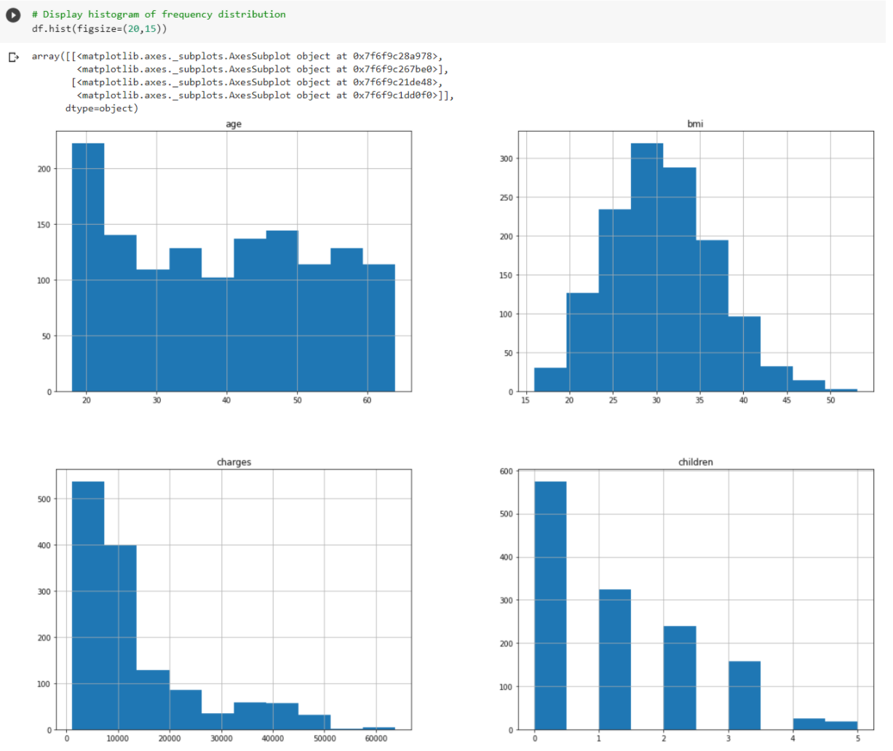
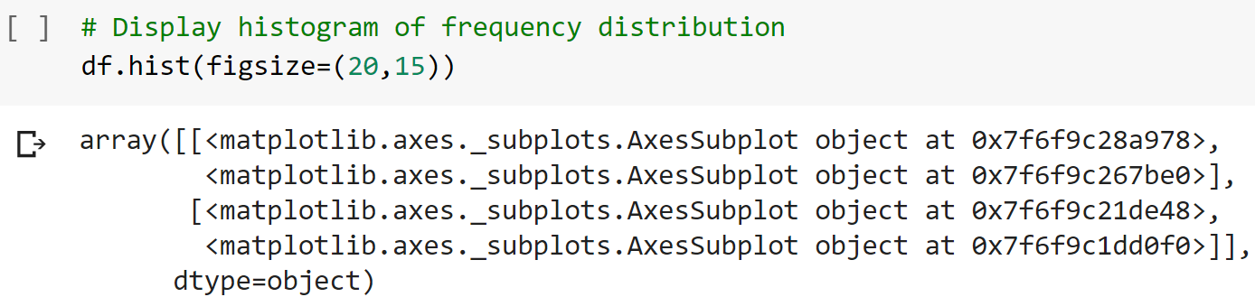
Data Visualisation

Slide 13
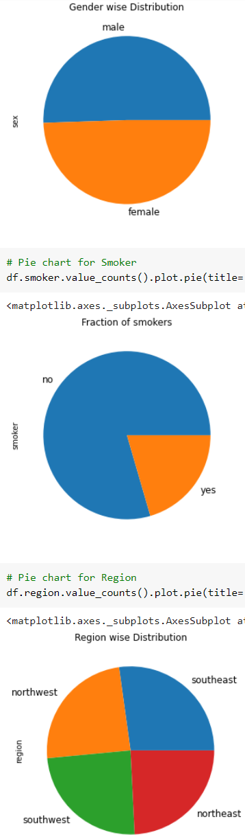
Distribution of Data
The distribution of categorical variables can be viewed in the form of pie charts as shown:

Slide 14
Correlation
Correlation was calculated using Spearman’s Correlation and Pearson’s Correlation
Spearman’s Correlation
Charges & Age : +0.534
Charges & BMI : +0.119
Charges & Number of Children : +0.133
Pearson’s Correlation
Charges & Age : +0.299
Charges & BMI : +0.198
Charges & Number of Children : +0.068

Slide 15
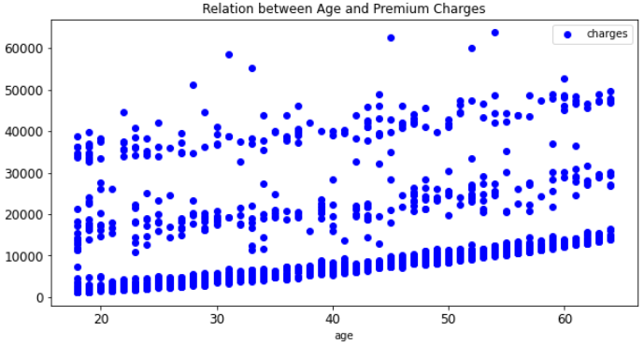
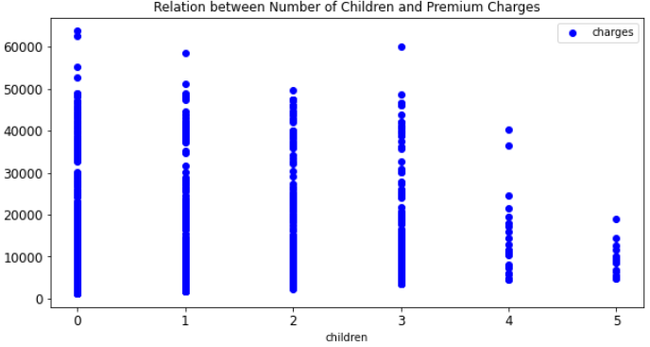
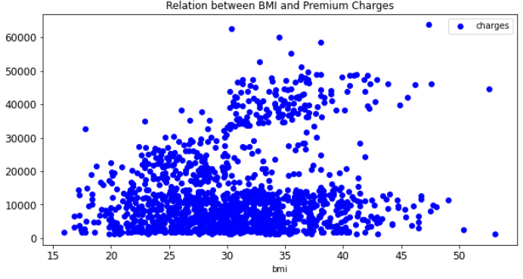
Relation between X & y

Slide 16
Regression

Slide 17
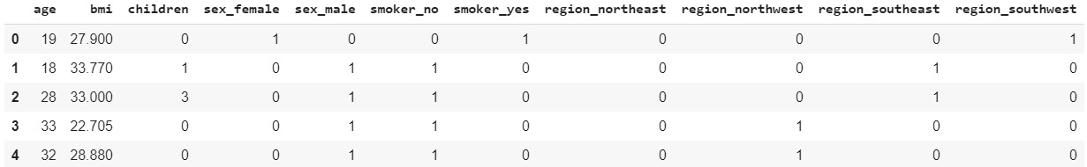
One Hot Encoding
In order to include categorical variables in the Regression model, we used One Hot Encoding.
Each value of each categorical variable was converted to a new variable as shown:

Slide 18
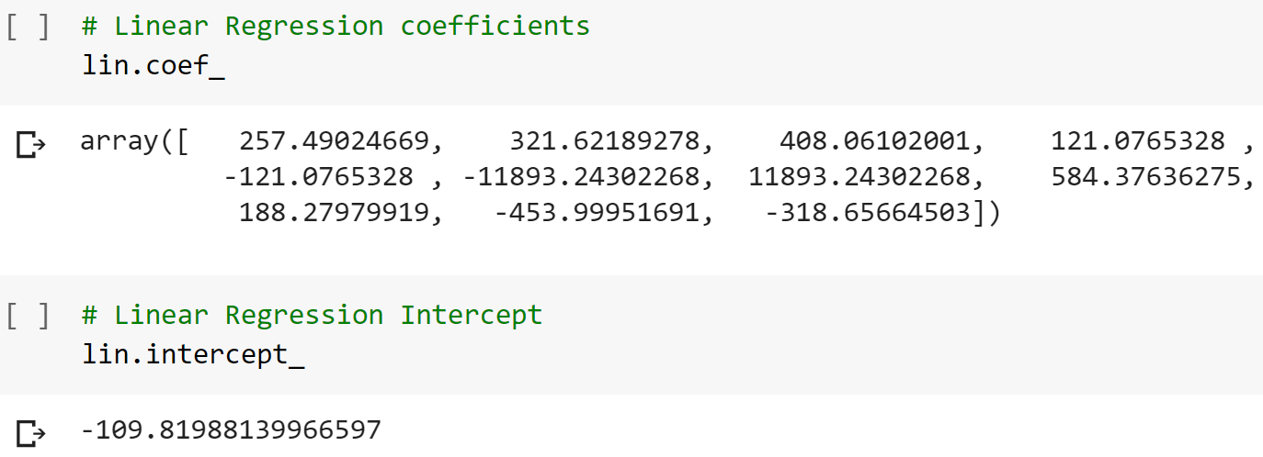
Linear Regression Model
The Intercept and Coefficients of the 11 variables are obtained to form Linear Regression Model

Slide 19
Polynomial Regression
In order to achieve better performance from regression model, we also used Polynomial Regression of Degree 2 & 3.
The following parameters were computed in order to compare the performance of the models (Linear, Polynomial Degree 2, Polynomial Degree 3)
Root Mean Squared Error
Mean Absolute Error
Explained Variance Score
R² Score

Slide 20
Regression Model Performance
Linear Regression
Root Mean Squared Error 5956.454717976427
Mean Absolute Error 4051.858766747046
Explained Variance Score 0.7623598740020212
R² Score 0.7623311844057112
Polynomial Degree 2
Root Mean Squared Error 4586.3772326492235
Mean Absolute Error 2675.5940037189325
Explained Variance Score 0.8590975976232729
R² Score 0.8590918676722223
Polynomial Degree 3
Root Mean Squared Error 5404.261594461826
Mean Absolute Error 3402.1903988409513
Explained Variance Score 0.8045289516959546
R² Score 0.8043547813189561

Slide 21
Conclusion
&
Future Scope of Work

Slide 22
Conclusion
Out of Linear Regression, Polynomial Regression of Degree 2 and Polynomial Regression of Degree 3, the best performance was obtained using Polynomial Regression of Degree 2.
The R² value of best performing model, that is, Polynomial Regression with Degree 2 is 0.859.

Slide 23
Insights from Analysis
There is a positive correlation between :
Premium Charges and Age of the person
Premium Charges and BMI of the person
Premium Charges and number of children of the person
Premium charged is directly proportional to the risk to the health of an individual and the number of dependents he has.
Older people, people with higher BMI, people with children have a higher risk and impact of risk associated with them and hence are charged higher premium.
The customer dataset for a health insurance company shall have an optimised mix of low risk (low premium) and high risk (high premium) customers to make the insurance business viable.

Slide 24
Future Scope of Work
The analysis can be detailed further by including more variables (eg, past medical records) that impact a person’s health. These variables can further be segregated to have specific variables to predict risk for different diseases. For example, smoking is more relevant to respiratory diseases. This would help insurance companies calculate appropriate premium for different insurance packages / covers offered.
Business and Data Analytics can also be used by insurance companies to define the optimal mix of its customers.

Slide 25
Important Links
Dataset link:
https://www.kaggle.com/simranjain17/insurance
Github link:
https://github.com/Lakshayti/Health-Insurance-Premium-Prediction

Slide 26
Thank You!

